Slide 1
Hospital Management System
Before we understand how databases are work on Hospital Management System. We will have to be understand what are the applicants and their works and how they are connected to each other. For this we have to be understand how many schema/table are present in the hospital management system. Let’s begins with the login frame of our project.

Slide 2
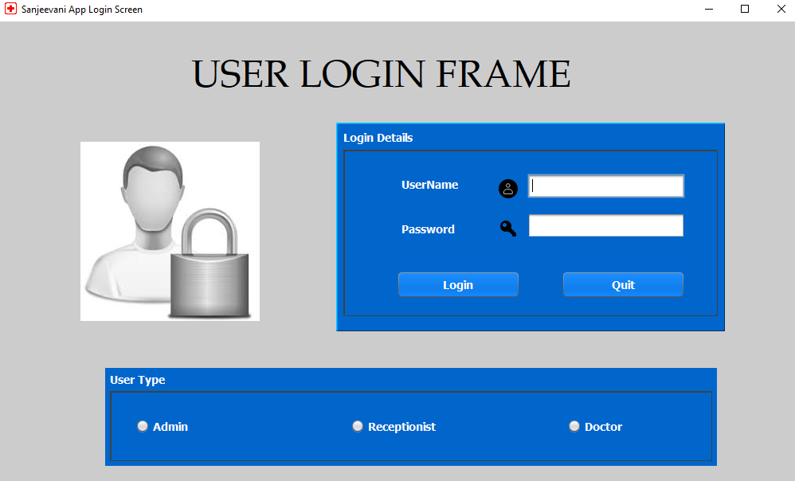
Hospital Management System
Login Frame:-

Slide 3
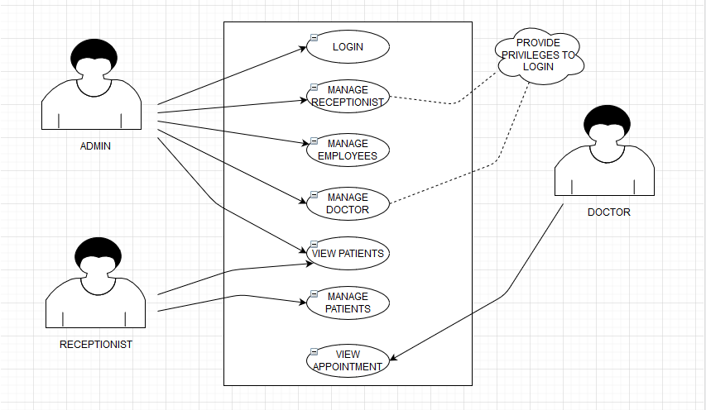
Hospital Management System
Case Diagram:-

Slide 4
Hospital Management System
We have seen the case diagram of our project.
There are total three applicants are present in our project and each have some functionality to perform operations and connect to database directly or indirectly. Let us discuss what are the point which is very important to discuss before further explanation.

Slide 5
Hospital Management System
Some Important points to be remember:-
Before launching our project , We have to make login Id and password for ADMIN explicitly via writing SQL command by own.
After then we can add employees like receptionist , doctor etc. And give some special privileges to log in as receptionist and doctor.
So finally we have three applicants who can logged In in this app and take a responsibility to work with.
As we see in case diagram the admin can login, Manage receptionist, Manage doctor, view patient. And similarly receptionist can manage the patient and doctor can view the appointment of the patient etc.
So that’s all about case diagram. Now we will see the structure of our database table and then elaborate it.

Slide 6
Hospital Management System
There are four table work in our project which are as follows:-
USERS
EMPLOYEES
DOCTORS
PATIENT

Slide 7
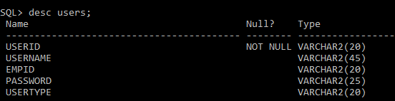
Hospital Management System
Users table Details

Slide 8
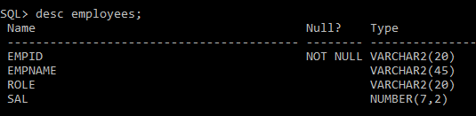
Hospital Management System
Employees table Details

Slide 9
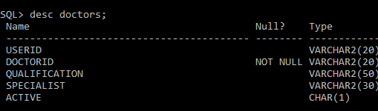
Hospital Management System
Doctors table Details

Slide 10
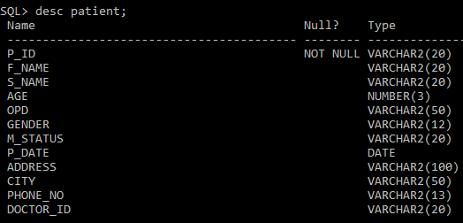
Hospital Management System
Patient table Details

Slide 11
Hospital Management System
Now, We will see the ER Diagram of our project. Before we see the ER Diagram, Let’s discuss the key point of the diagram which I prepared in some specific way. After see the ER diagram your confusion about table like what primary key in table become the foreign key in the another table. I assure you that your all doubts are crystal cleared after reading it. Now I would like to discuss some key point to be remember so you can easily fetch the motive of ER diagram.
The Table/entity are represented by rectangle.
The attribute of the table are represented by ellipse.
The attribute which has a primary key are represented by ellipse with underline. And I have add the char like “P”, “F” which represent primary key and foreign key respectively.
A relation in a tables are represented by diamond and connecting the entity with line which has also contains a special role.

Slide 12
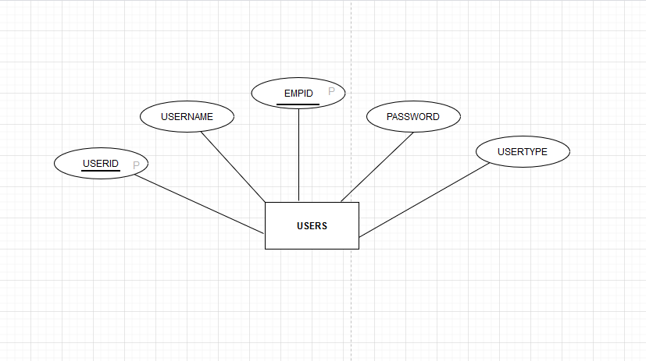
Hospital Management System
Individual Diagram of Users :-
F

Slide 13
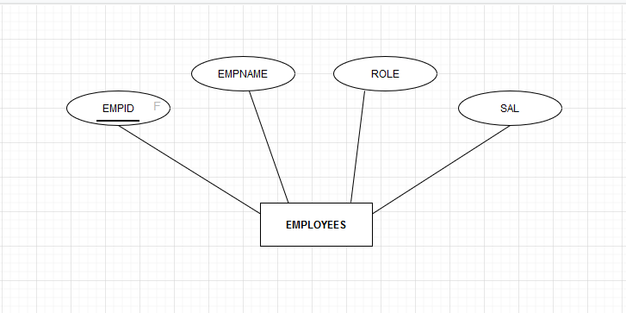
Hospital Management System
Individual Diagram of Employees :-

Slide 14
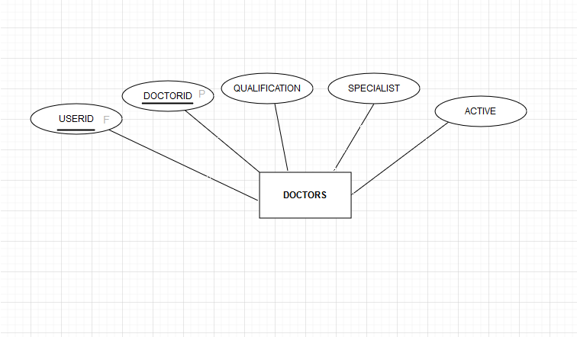
Hospital Management System
Individual Diagram of Doctors :-

Slide 15
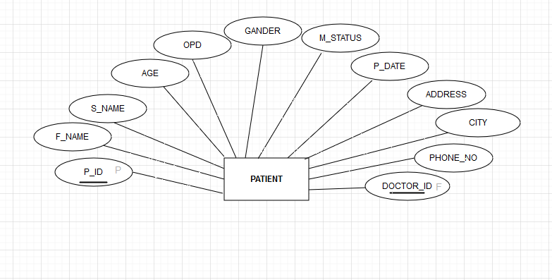
Hospital Management System
Individual Diagram of Patient :-

Slide 16
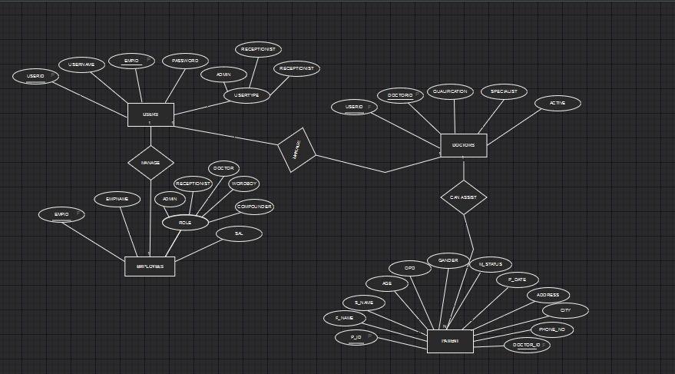
Hospital Management System
Final ER Diagram:-

Slide 17

THE END
For any queries mail me @: shuvambhopal@gmail.com
Call me @ : 8962780997

